Slide 1
Mips processor – SoC Team
Top level design
Pawan kumar, Vaishnavi matte, ayut ghosh, sandipan Chatterjee, shreyan datta

Slide 2
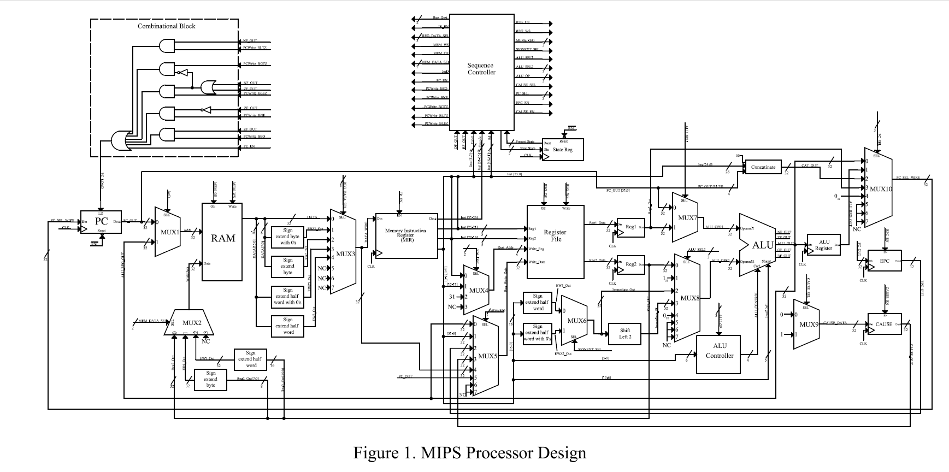
Schematic diagram

Slide 3
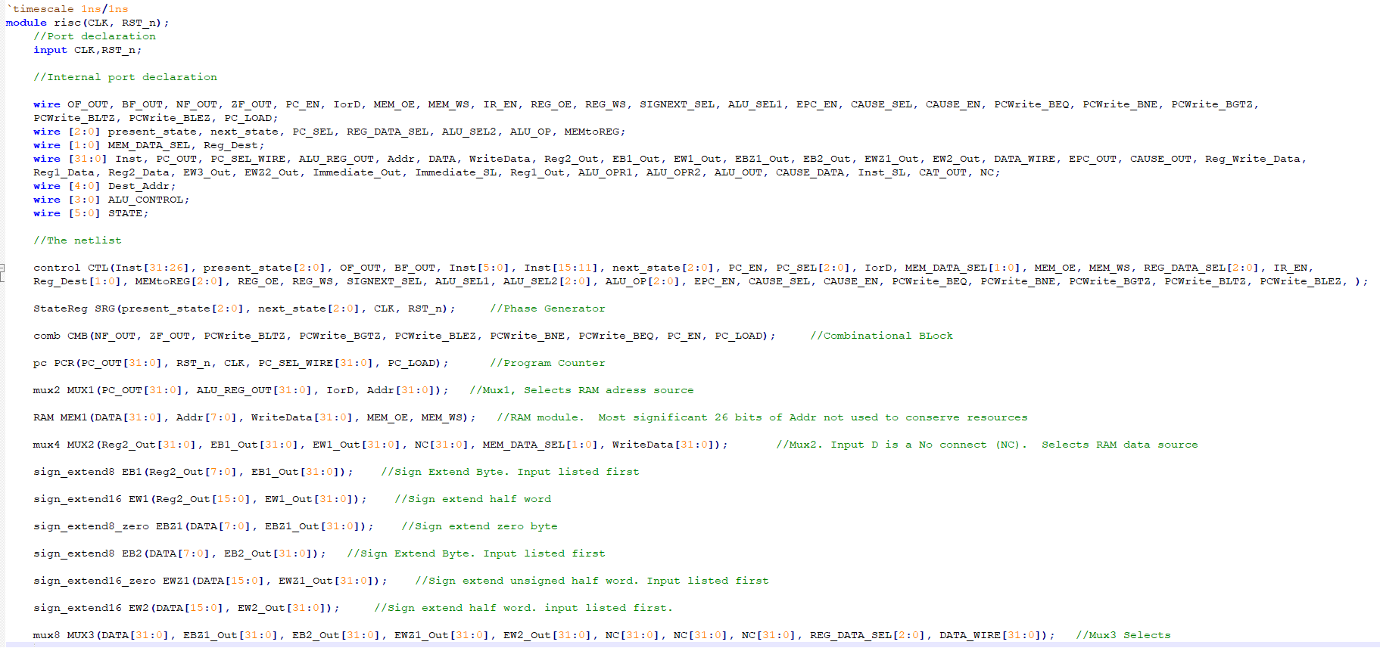
Source code
Complete_Code

Slide 4
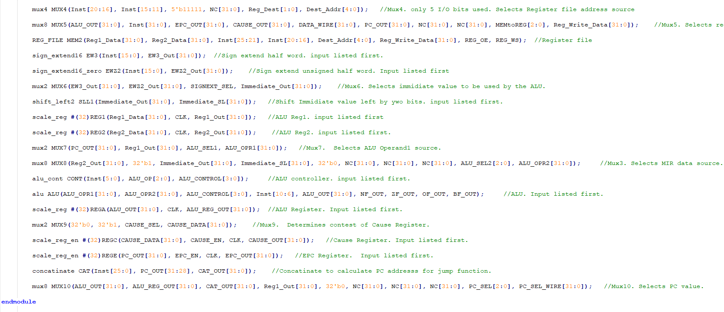

Slide 5
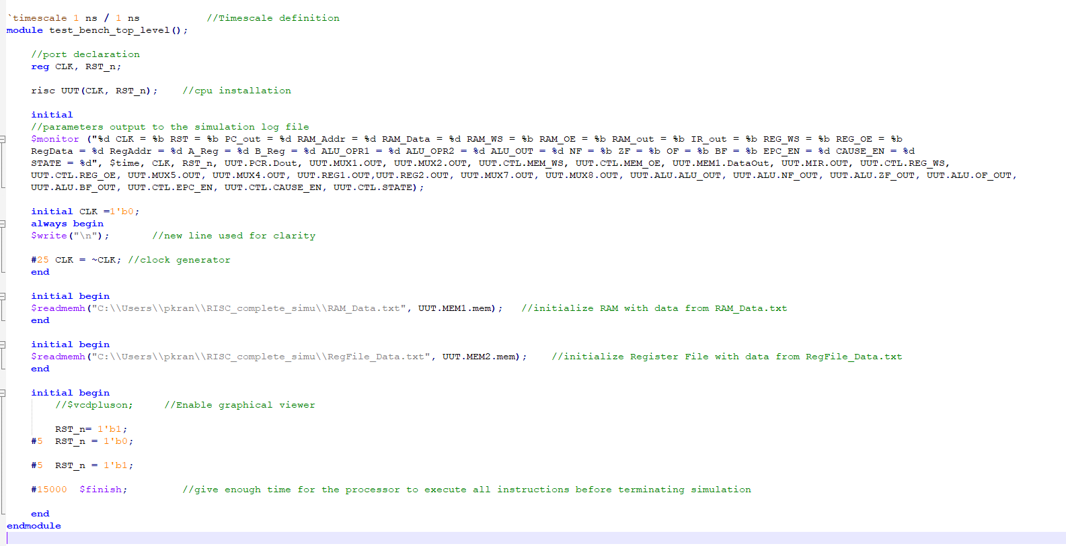
Test bench

Slide 6
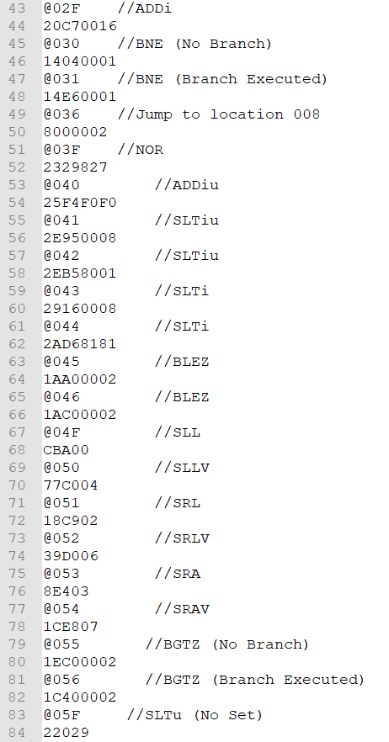
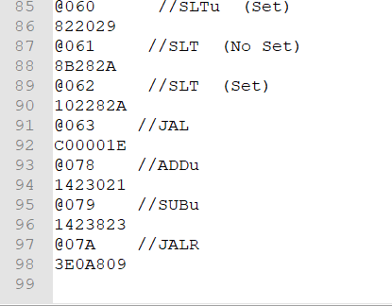
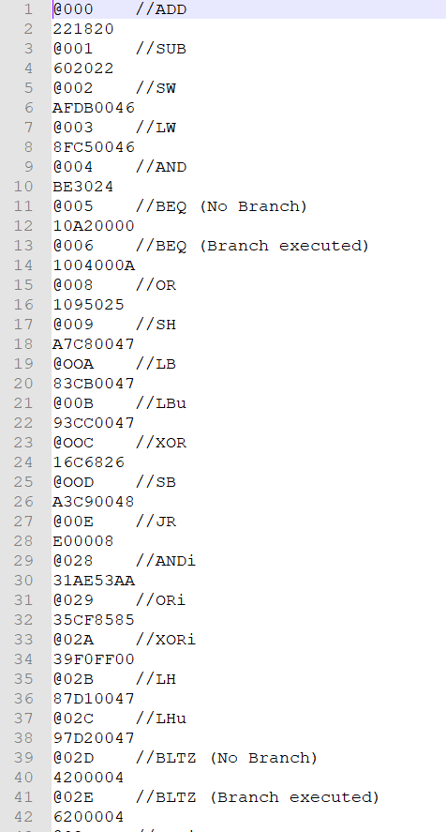
RAM_Data.txt file

Slide 7
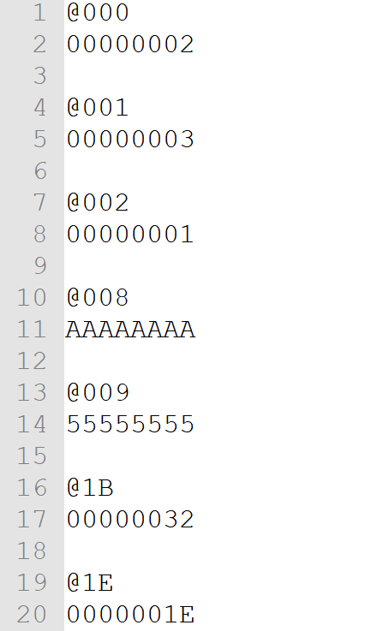
regFile_Data.txt file

Slide 8

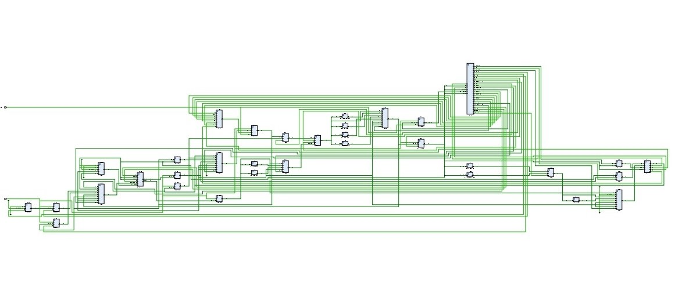
Schematic diagram

Slide 9
TCL console output
TCL_OUTPUT
TCL output shows status of all the outputs for each operation mentioned in RAM.txt file. As file length is very large therefore for convenience output for only one operation is shown here.

Slide 10
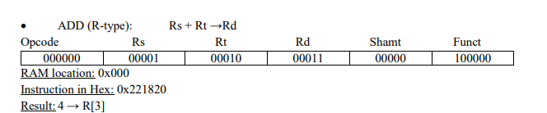
Addition operation
5 CLK = 0 RST = 0 PC_out = 0 RAM_Addr = 0 RAM_Data = x RAM_WS = 0 RAM_OE = 1 RAM_out = 00000000001000100001100000100000 IR_out = xxxxxxxxxxxxxxxxxxxxxxxxxxxxxxxx REG_WS = 0 REG_OE = 1 RegData = 1 RegAddr = X A_Reg = x B_Reg = x ALU_OPR1 = 0 ALU_OPR2 = 1 ALU_OUT = 1 NF = 0 ZF = 0 OF = 0 BF = 0 EPC_EN = 0 CAUSE_EN = 0 STATE = 0
10 CLK = 0 RST = 1 PC_out = 0 RAM_Addr = 0 RAM_Data = x RAM_WS = 0 RAM_OE = 1 RAM_out = 00000000001000100001100000100000 IR_out = xxxxxxxxxxxxxxxxxxxxxxxxxxxxxxxx REG_WS = 0 REG_OE = 1 RegData = 1 RegAddr = X A_Reg = x B_Reg = x ALU_OPR1 = 0 ALU_OPR2 = 1 ALU_OUT = 1 NF = 0 ZF = 0 OF = 0 BF = 0 EPC_EN = 0 CAUSE_EN = 0 STATE = 0
25 CLK = 1 RST = 1 PC_out = 1 RAM_Addr = 1 RAM_Data = x RAM_WS = 0 RAM_OE = 0 RAM_out = 00000000001000100001100000100000 IR_out = 00000000001000100001100000100000 REG_WS = 0 REG_OE = 1 RegData = 24705 RegAddr = 2 A_Reg = x B_Reg = x ALU_OPR1 = 1 ALU_OPR2 = 24704 ALU_OUT = 24705 NF = 0 ZF = 0 OF = 0 BF = 0 EPC_EN = 0 CAUSE_EN = 0 STATE = 1
50 CLK = 0 RST = 1 PC_out = 1 RAM_Addr = 1 RAM_Data = x RAM_WS = 0 RAM_OE = 0 RAM_out = 00000000001000100001100000100000 IR_out = 00000000001000100001100000100000 REG_WS = 0 REG_OE = 1 RegData = 24705 RegAddr = 2 A_Reg = x B_Reg = x ALU_OPR1 = 1 ALU_OPR2 = 24704 ALU_OUT = 24705 NF = 0 ZF = 0 OF = 0 BF = 0 EPC_EN = 0 CAUSE_EN = 0 STATE = 1
75 CLK = 1 RST = 1 PC_out = 1 RAM_Addr = 1 RAM_Data = 1 RAM_WS = 0 RAM_OE = 0 RAM_out = 00000000001000100001100000100000 IR_out = 00000000001000100001100000100000 REG_WS = 0 REG_OE = 1 RegData = 4 RegAddr =3 A_Reg = 3 B_Reg = 1 ALU_OPR1 = 3 ALU_OPR2 = 1 ALU_OUT = 4 NF = 0 ZF = 0 OF = 0 BF = 0 EPC_EN = 0 CAUSE_EN = 0 STATE = 4

Slide 11
100 CLK = 0 RST = 1 PC_out = 1 RAM_Addr = 1 RAM_Data = 1 RAM_WS = 0 RAM_OE = 0 RAM_out = 00000000001000100001100000100000 IR_out = 00000000001000100001100000100000 REG_WS = 0 REG_OE = 1 RegData = 4 RegAddr = 3 A_Reg = 3 B_Reg = 1 ALU_OPR1 = 3 ALU_OPR2 = 1 ALU_OUT = 4 NF = 0 ZF = 0 OF = 0 BF = 0 EPC_EN = 0 CAUSE_EN = 0 STATE = 4
125 CLK = 1 RST = 1 PC_out = 1 RAM_Addr = 1 RAM_Data = 1 RAM_WS = 0 RAM_OE = 0 RAM_out = 00000000001000100001100000100000 IR_out = 00000000001000100001100000100000 REG_WS = 1 REG_OE = 1 RegData = 4 RegAddr = 3 A_Reg = 3 B_Reg = 1 ALU_OPR1 = 3 ALU_OPR2 = 1 ALU_OUT = 4 NF = 0 ZF = 0 OF = 0 BF = 0 EPC_EN = 0 CAUSE_EN = 0 STATE = 5
150 CLK = 0 RST = 1 PC_out = 1 RAM_Addr = 1 RAM_Data = 1 RAM_WS = 0 RAM_OE = 0 RAM_out = 00000000001000100001100000100000 IR_out = 00000000001000100001100000100000 REG_WS = 1 REG_OE = 1 RegData = 4 RegAddr = 3 A_Reg = 3 B_Reg = 1 ALU_OPR1 = 3 ALU_OPR2 = 1 ALU_OUT = 4 NF = 0 ZF = 0 OF = 0 BF = 0 EPC_EN = 0 CAUSE_EN = 0 STATE = 5
Analysis: 1 + 3 → 4 → RegFile[3]. Test results show that RegData = 4 and RegAddr = 3 while the REG_WS signal goes high on the last clock cycle. The next instruction uses R[3] to verify that the value 4 actually got latched. (NOTE: The operand values in R[1] and R[2] were initially stored into the Register File before the start of simulation using the $readmemh system Verilog task).

Slide 12
Simulators used
Icarus Iverilog – For Functional Verification
Vivado – For Functional Verification & Schematic

Slide 13
THANK YOU!

